Slide 1



PROJECT PRESENTATION
ON CMD
PRESENTING BY,
ABUBAKKAR SIDDIQ
ABISHEK SATISH
AMAN FAZLUR RAHEMAN SAYYAD
ASHISH KUMAR PANDAY
DEEPAK
DHARUN KUMAR
SAGAR AJINATH HONMANE
SANTHOSH KUMAR
SUBHIKSHA
GUIDED BY,
Mr. KRISHNA KUMAR,CTO at Pratian Technologies.

Slide 2

AGENDA
Project Objective
Project Introduction
Mission
Screen Listing
Features
Modules
Prototype
What we Deliver
Code Explanation
Execution Workflow
Generating Data
Key Highlights
Test Cases
Demo
Experience
Queries

Slide 3

PROJECT OBJECTIVE
CONNECT MY DOC- USER’S DOCTOR AT THE TOUCH OF A BUTTON!
Performance objectives
Business objectives
Financial objectives
Effectiveness objectives
Regulatory objectives
Technical objectives
Quality objectives

Slide 4
PROJECT INTRODUCTION
CONNECT MY DOC- USER’S DOCTOR AT THE TOUCH OF A BUTTON!
“Connect My Doc” app that aims to revolutionize medical care.
Now, you can get a doctor at the touch of a button. You can interact with a provider via CMD app.
A provider can also use this app to scope out your sniffles via video chat, prescribe medicine, and also track symptoms from afar.
Connect My Doc provide multi appointments in one view, which will help to plan your time better.
This app helps to connect with a group of doctors.
The CMD app gives you simple and secure access to our innovative healthcare services. It enables the providers to send prescriptions or reports as part of a medical tele-consultation. Available anywhere and without the hassle of the waiting room.

Slide 5

MISSION
Decentralized, Mobilized & Personalized Healthcare Delivery
Remote Patient Monitoring, Consultation, Diagnosis, and Teaching
It includes:
Secure Chats with Role Based Access
All types of Media Share Like Image, Video or Documents.
Group Conversations
Virtual Follow Ups / Appointments, as calls
Digital & Centralized Patient Document Repository & Profiles
.

Slide 6
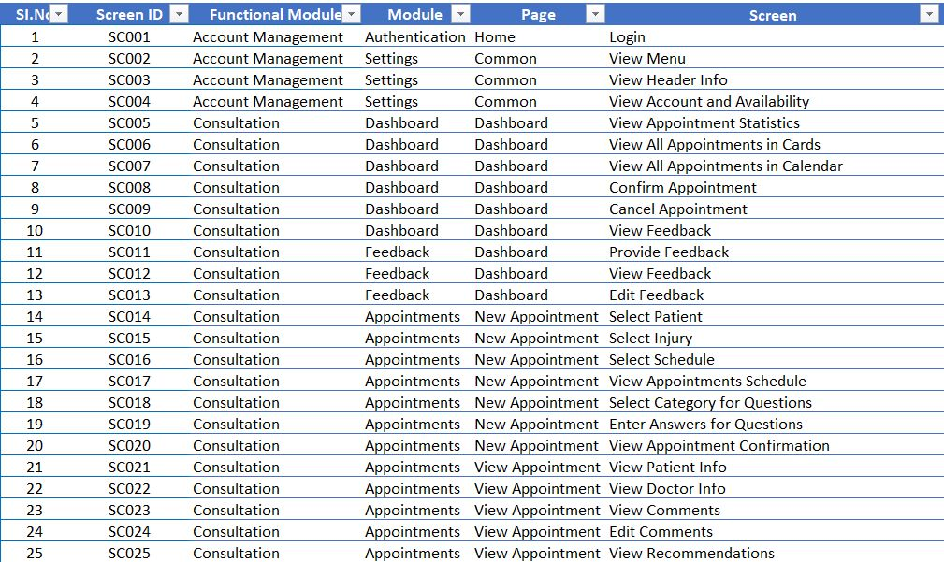
SCREEN LISTING
.

Slide 7
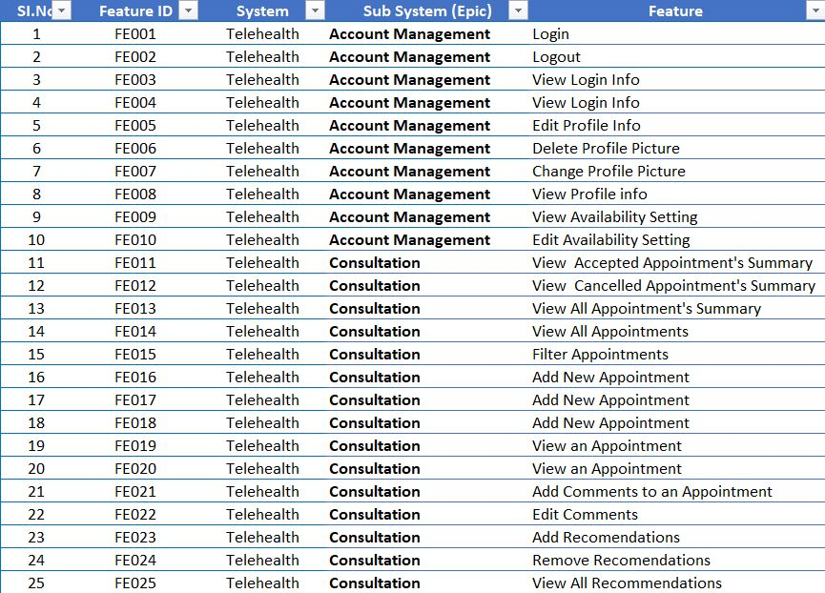
FEATURES
.

Slide 8
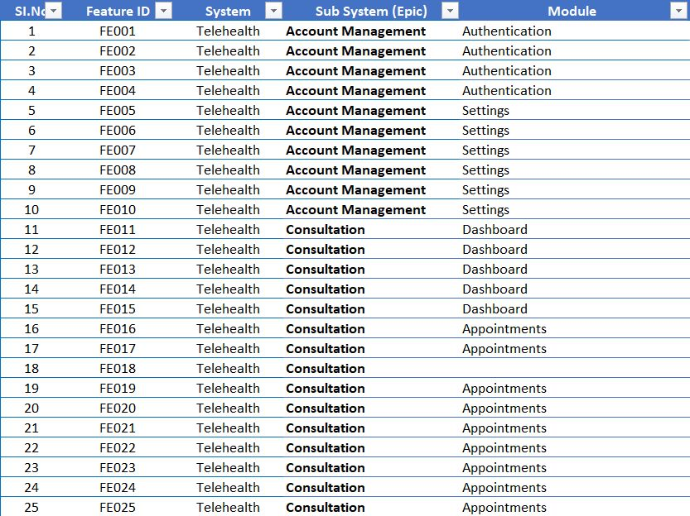
MODULES
.

Slide 9
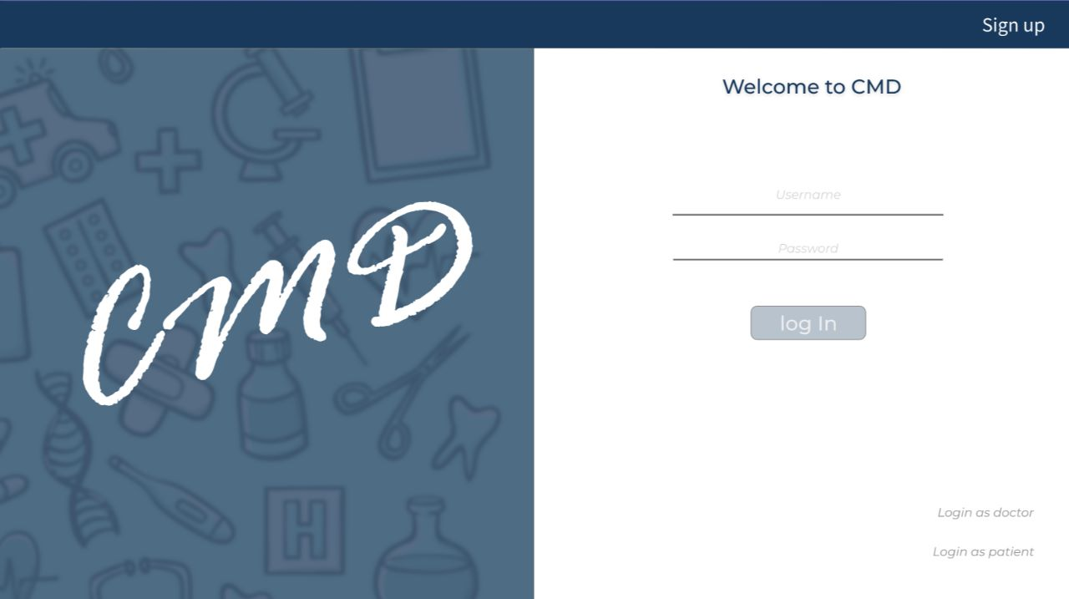
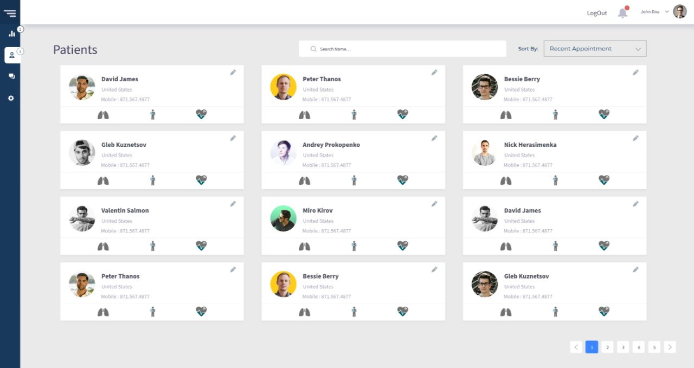
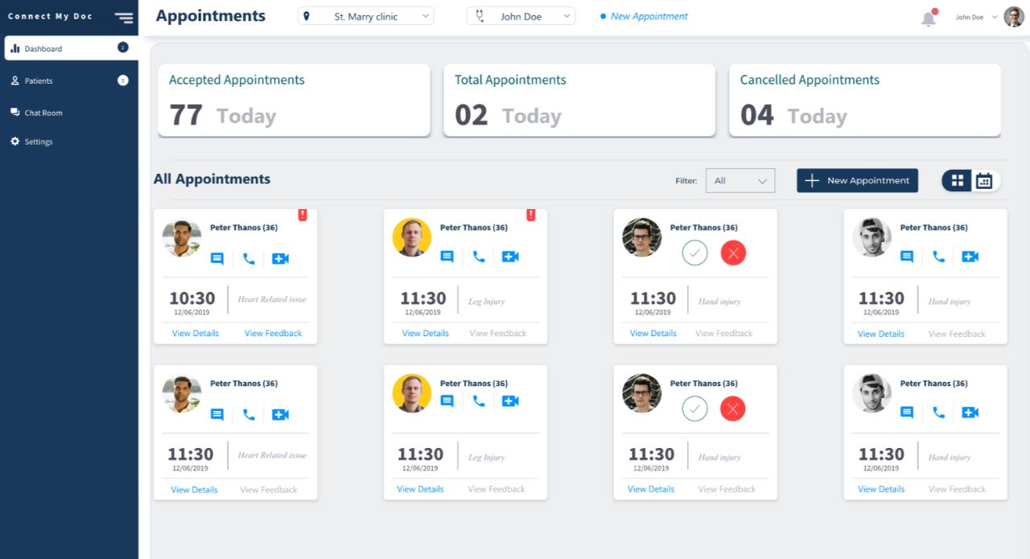
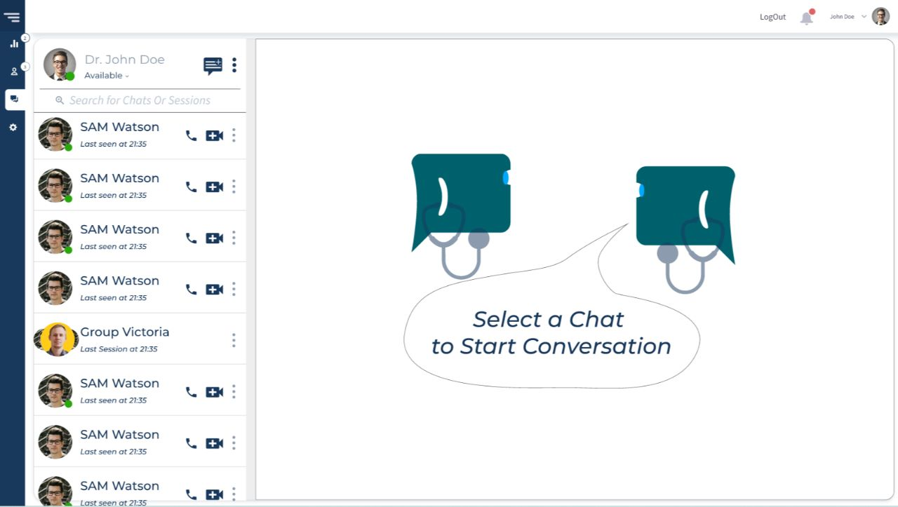
PROTOTYPE
.

Slide 10
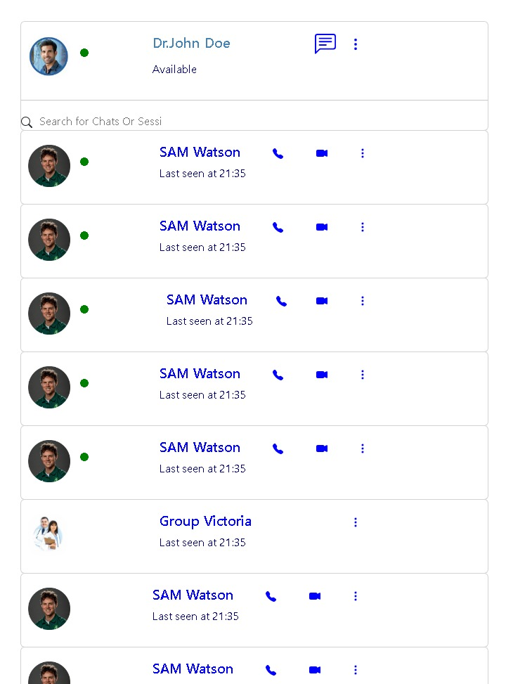
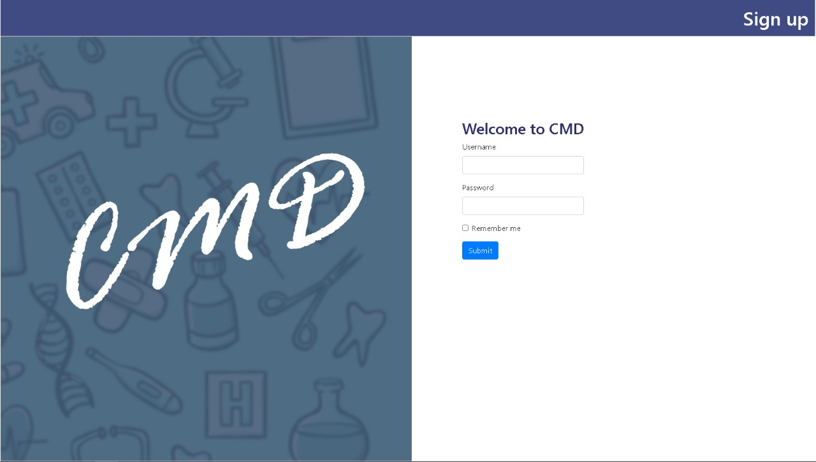
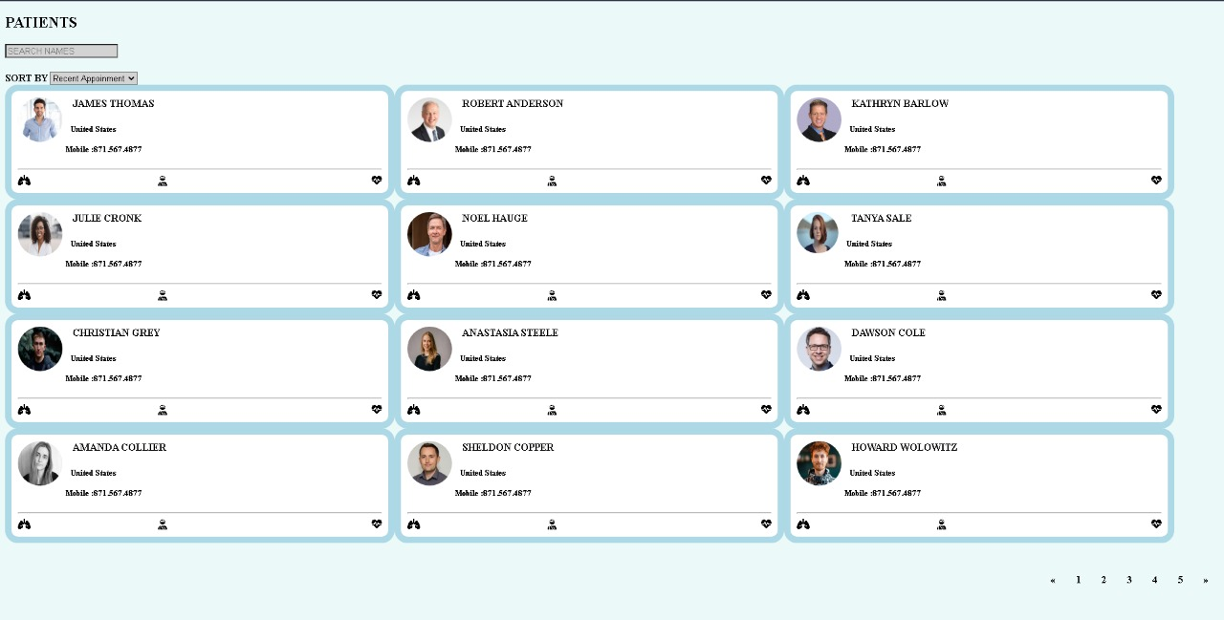
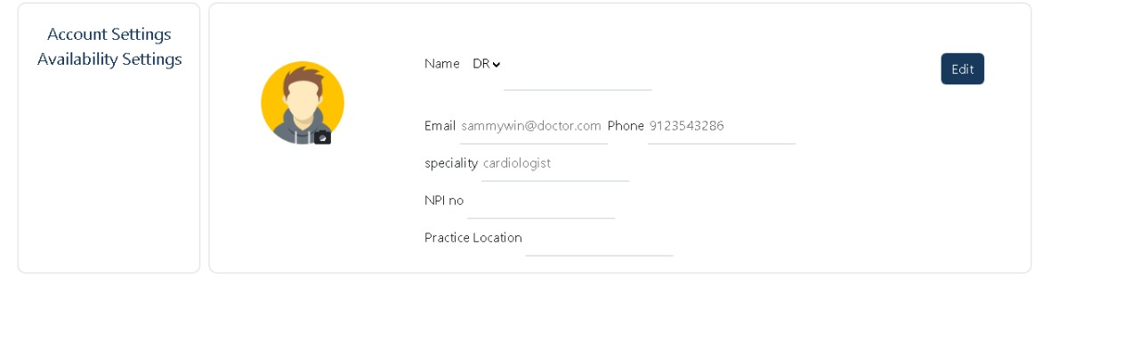
WHAT WE DELIVER
.

Slide 11
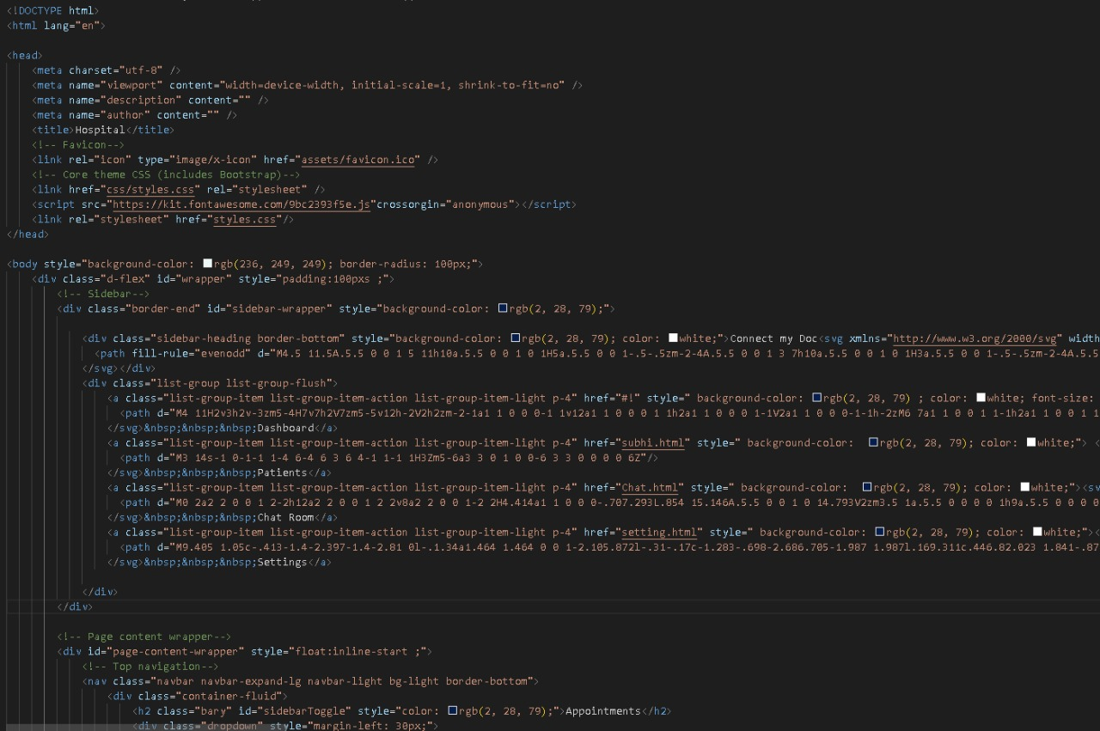
CODE EXPLANATION
LOGIN AND DASHBOARD
.

Slide 12
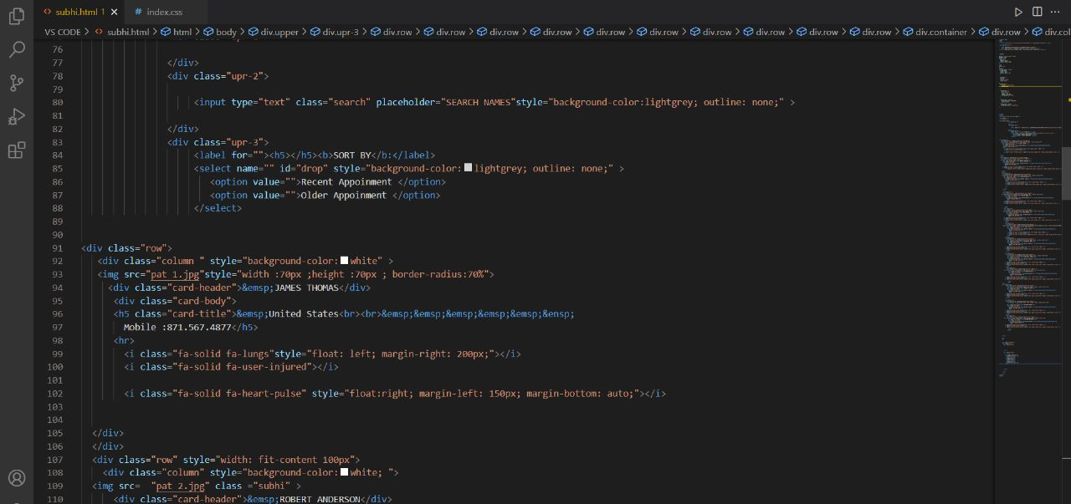
CODE EXPLANATION
PATIENTS
.

Slide 13
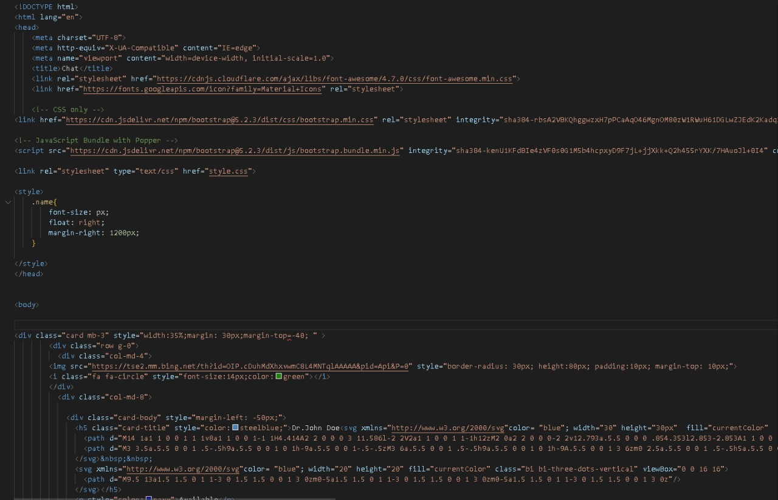
CODE EXPLANATION
CHAT BOX
.

Slide 14
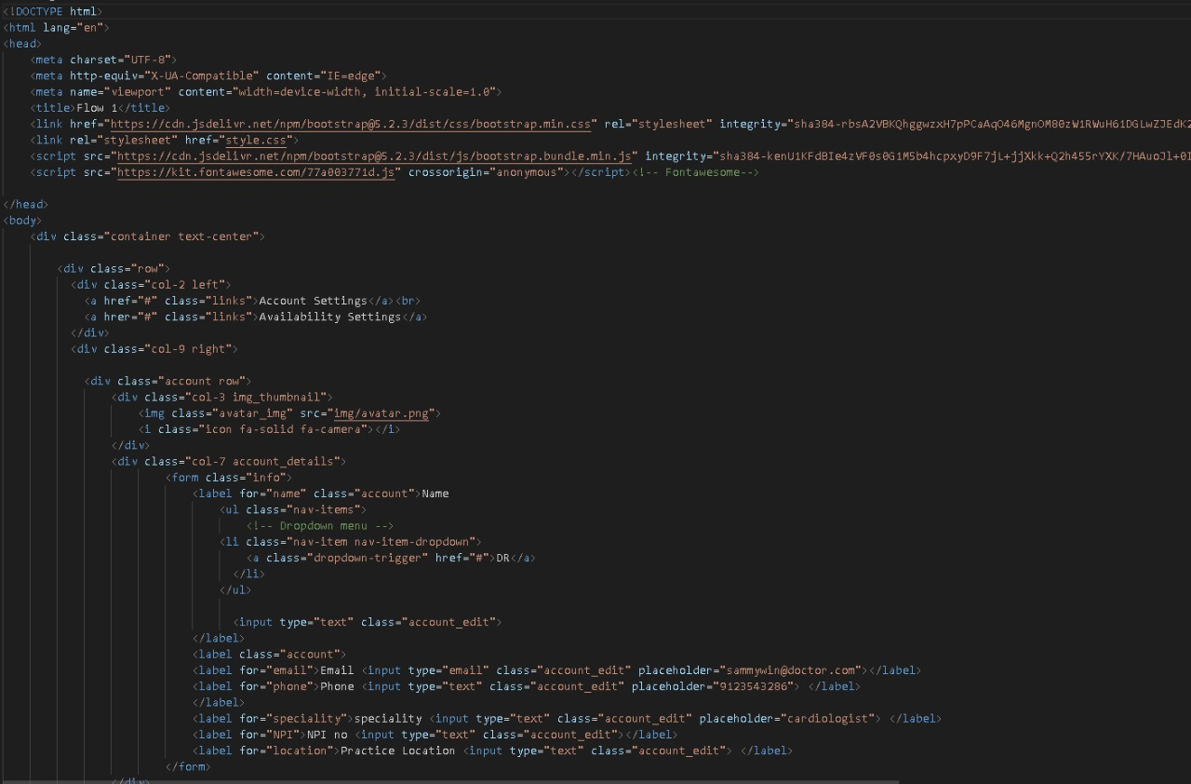
CODE EXPLANATION
SETTINGS
.

Slide 15
EXECUTION WORKFLOW
1.
REQ UNDERSTANDING
2.
USER’S ANALYSIS OF PROBLEM STATEMENT
3.
ANALYSIING THE PROTOTYPE
4.
SPLIT OUR WORKS ON DASHBOARD
5.
LOGIN PAGE
6.
MAIN DASHBOARD
7.
PATIENTS
8.
CHATS
9.
SETTINGS
10.
REVIEW PRESENTATION
.

Slide 16
DATA GENERATION
METHODS WE HAVE INCOPORATED
BOOTSTRAP
HTML5.0 AND CSS3
FONT AWESOME
OUTCOMES
SECURE CHATS WITH ROLE BASED ACCESS
ALL TYPES OF MEDIA SHARE LIKE IMAGE, VIDEO OR DOCUMENTS.
GROUP CONVERSATIONS
VIRTUAL FOLLOW UPS / APPOINTMENTS, AS CALLS
DIGITAL & CENTRALIZED PATIENT DOCUMENT REPOSITORY & PROFILES
.

Slide 17
KEY HIGHLIGHTS
TIME BASED APPROACH
PROFESSIONAL BOOTSTRAP
DEVICE COMPATIBLE
LATEST HTML
INTEGRATED THE APPLICATION
LINES OF CODES = 1307 lines of code
SELF AND TEAM LEAD REVIEWING
QUALITY CHECK

Slide 18
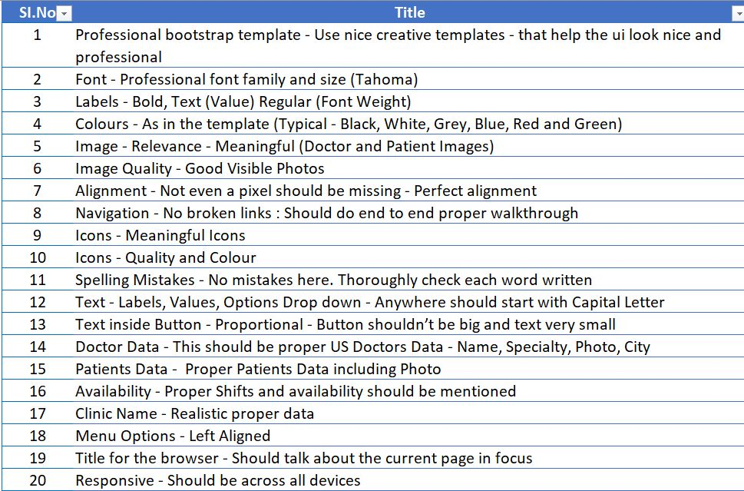
TEST CASES
.

Slide 19

DEMO
.

Slide 20

EXPERIENCE
.

Slide 21

QUERIES
.

